Slide 1
Andy Lankshear
Kanda University of International Studies
Center for Teaching English to Children
Intentional Gestures

Slide 2
What are intentional gestures?
Intentional, pre-planned gestures done concurrently with speech
which:
help convey meaning
help support retention of common phrases and questions
support phrasal syntax
support prosodic performance (rhythm, intonation, stress)
provide routine
can be used in whole class teaching and one-on-one situations to support recasting and rephrasing
are fun

Slide 3
What they are not
New – similar to Guoin (1880)
Total Physical Response (TPR)
a comprehensive system to teach everything.
Notes:
Gestures are not new, nor is their use in everyday communication or education. Gouin in 1880 devised a teaching technique called ‘Series’ that inspired classroom action sequences like ‘I’m walking to / opening / closing the door’, and so on (Howatt & Smith, 2014, p.84). What differentiates Intentional Gestures is that they employ more rhythm and exclamations. They are also a planned and systematic way to teach short language phrases using concurrent gestures to support their meaning, encoding and retention. They can be used in whole class teaching, and in one-on-one situations to support recasting, rephrasing and correcting of students' speech attempts.
Intentional Gestures (IGs) are not Total Physical Response (TPR), a popular and effective way to convey meaning and promote comprehension through 'listen and do' activities . In TPR, the actions are a response to the spoken commands of the teacher or other students. In IGs, the gestures are enacted concurrently with the spoken language, which is then mimicked by your students in order to provide a physical mode, in addition to the aural mode, in which to retain and recall the target language in the students' heads. IGs are not intended to be overused nor to provide a comprehensive system to teach everything. I think there is a point at which all those gestures will get muddled and would then need to be systemically taught, to the point it may feel like you are teaching a sign language in addition to the target language. I don't know when that point is, but I think it is reasonable to leave it up to your professional judgement on how many gestures are too many. Instead, I intend IGs to be an additional tool in your teacher toolkit, which you can use to provide further variety and interest for your students in addition to your current teaching practices.

Slide 4
Gestures
“Gestures provide building blocks that can be used to construct a language”
(Goldin-Meadow, S & Wagner Alibali, M., 2013, p. 257).
emblemic, iconic or pantomimic
Multimodality - audio, visual and motor
stronger impact than pictures
(see Marion Tellier, 2008)
reduces the cognitive load
Notes:
Gesture is non-verbal but that doesn’t mean it is non-linguistic. In fact, speech and gesture are inextricably linked, forming an integrated (or ‘coupled’) system. As McNeill (2012: 31) puts it, ‘gestures and synchronous speech are … co-expressive but not redundant: they express the same idea each in its own way – often each its own aspects of it’. Thus, gesture is not just an ‘add-on’, a way of ornamenting speech. Gesture and speech originate together, and are precisely synchronized.
They may also help link language and cognition by activating mirror neurons: seeing you gesture makes me feel as if I’m gesturing, and hence I’m connected to the thinking that motivated the gesture (Thornbury, 2013).

Slide 5
Story
sequence and consequence
(Riessman, 2004)
The sequence assists learners to recall the next language by providing a structure.
e.g. A student’s day.
The consequences of the story are:
humour imagination links to own experiences

Slide 6
Chunking ‘Multi-word units’, ‘formulaic sequences’, 'standardised phrases', 'lexical phrases’ “Items that are used together, fuse together.” (Bybee, 2003)
Lexical Approach (Lewis, 1993)
aids instantaneous production
decreases cognitive load
“Fluent speakers do not create new sentences by choosing one word at a time, but rather by using strings of words that typically occur together.” (Lightbown & Spada, 2013, p. 109)
For L2 learners, frequency of input determines fluency. (Ellis, Simpson-Vlach & Maynard, 2008)
Notes:
From a teacher's point of view, the learn-a-language-by-learning-its-rules strategy rests on the belief that rule learning makes language learning more efficient. The idea is:
Learn a few score rules; learn a few thousand words; and presto!... You have mastered the language in the easiest way possible."
But research in recent decades suggests that knowledge of rules is of help almost exclusively when...
learners have time to prepare their thoughts before they communicate (e.g., before they make a presentation)
or when they have time to self-monitor (e.g., when writing an essay at home).
when language learners engage in spontaneous language, they rarely resort to formal grammar. The reason for this is that it is extremely hard to focus on meaning and grammar at the same time. So, in real-time language production, learners' attention to accuracy tends to be sacrificed to their immediate need to convey meaning.
So how is it that native-speakers can, in general, speak both fluently and accurately? The answer appears to be that spontaneous language relies heavily on stringing together memorised multi-word expressions-that is, whole phrases which are in our memories as chunks of words. Like “I gotta go!” “No way” and “IT&s neither here nor there.”
Young language learners in particular don’t have massive exposure to English like native-speakers do. Nevertheless, increasing numbers of researchers and teachers are coming to believe that the gaining fluency through chunking can also be achieved by EFL learners. In the target language depleted environment of EFL it is also good to offer lots of repetition of the chunks – frequent and spaced reptition over a few months at least.

Slide 7
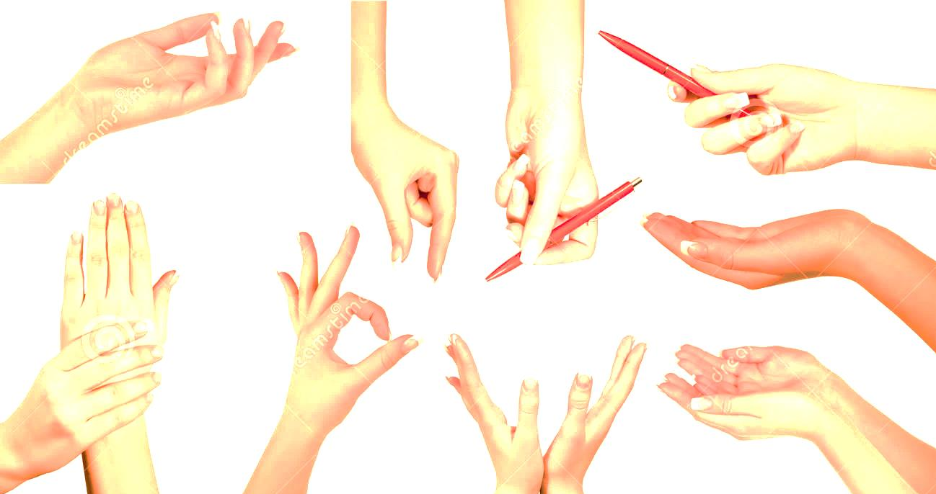
Methodology
Do over half the phrases on first day (front-loading).
Repeat it every lesson and introduce a new phrase.
Conduct: gradually just do the gestures and don't say anything.
Students do it in pairs.
Get a student to lead it.
Add modals and sentence starters to the phrases: e.g. I can - ; May I - ; I want to - ; I have to -; I want to ___ but I have to ____
Encourage them to use the phrases in role plays.
Introduce a new IG.
For example, ‘Trip to Mars’, ‘Going Shopping’
Notes:
1. Do over half the phrases on the first day. Teachers (and parents) will be surprised by how much English the students can produce on their first day! I call this front-loading. This is the concept of teaching a lot from the beginning, and repeating it many times so that the chances for the students' retention can be increased. This approach conflicts with many textbooks which typically teach a chunk, then another chunk with little or no repetition. 2. Repeat it every lesson. Surprisingly, the students don't get bored, as long as you are also introducing some new phrases each time and making it fun. 3. Gradually just do the gestures and don't say anything. Be like a conductor of your class, so that while doing the gestures your students will say the associated phrases, and voila! You have evidence that the target phrases have been internalized. 4. Once proficient, get a student to lead it. 5. Get the students do it in pairs, with one student gesturing and the other saying the target phrases. Then they swap roles. 6. Add modals and sentence starters to the phrases: e.g. I can - ; May I - ; I want to - ; I have to -; I want to ___ but I have to ____ ; Do you want to - etc...

Slide 8
Website
www.intentionalgestures.weebly.com

Slide 9
References
Bybee, J. (2003). Sequentiality as the basis of constituent structure. In T. Givon & B.F. Malle (Eds.), The evolution of language out of pre-language. Benjamins, Amsterdam, pp. 109-132.
Ellis, N.C., Simpson-Vlach, R. & Maynard, C. (2008). Formulaic language in native and second language speakers: Psycholinguistics, corpus linguistics, and TESOL. TESOL Quarterly, 42 (3), pp. 375-396.
Goldin-Meadow, S. & Wagner Alibali, M. (2013). Gesture’s role in speaking, learning and creating language. Annual Review of Psychology, 64. pp. 257-283.
Howatt, A.P.R & Smith, R (2014). The history of teaching English as a foreign language, from a British and European Perspective. Language and History, Vol. 57 No. 1, 75–95
Laufer, B. & Nation, I.S.P. (2013). Vocabulary .In S.M. Gass & A. Mackey (Eds.). Routledge Handbook of Second Language Acquisition. Taylor & Francis, Florence, pp. 163 – 176.
Lewis, M. (1993). The lexical approach: The state of ELT and the way forward. Hove, England: Language Teaching.
Lightbown, P.M. & Spada, N. (2013) (4th ed.). How languages are learned. Oxford University Press. Oxford, UK.
Riessman, C.K. (2004) Narrative Analysis in M.S. Lewis-Beck, A. Bryman and T. Futing Liao (Eds.). The Sage Encyclopedia of Social Science Research Methods. Sage, DOI: http://dx.doi.org/10.4135/9781412950589.
Tellier, M. (2008). The effects of gestures on second language memorisation by young children. Gesture 8:2 pp. 219 – 235.
Thornbury, S (2013). G is for gesture. Online resource.
https://scottthornbury.wordpress.com/2013/05/26/g-is-for-gesture/

Slide 10
Thanks for listening!

